Slide 1
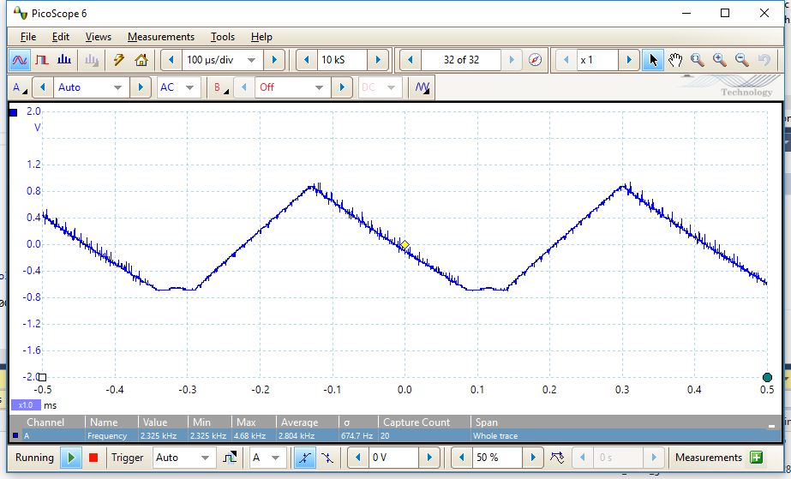
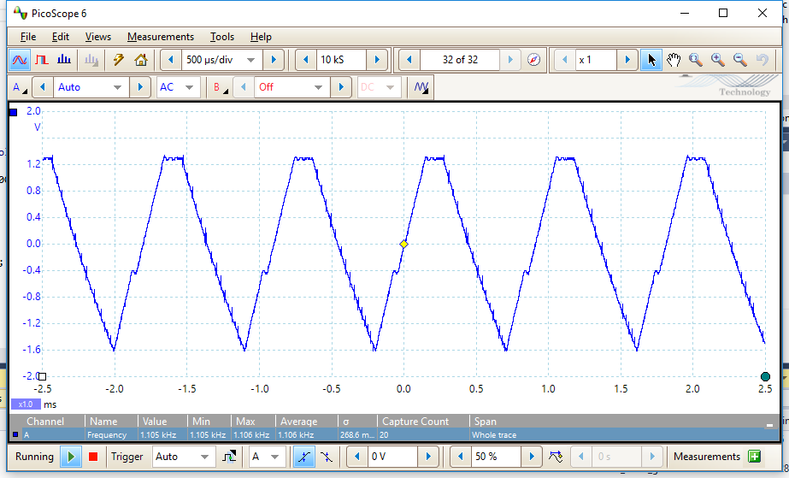
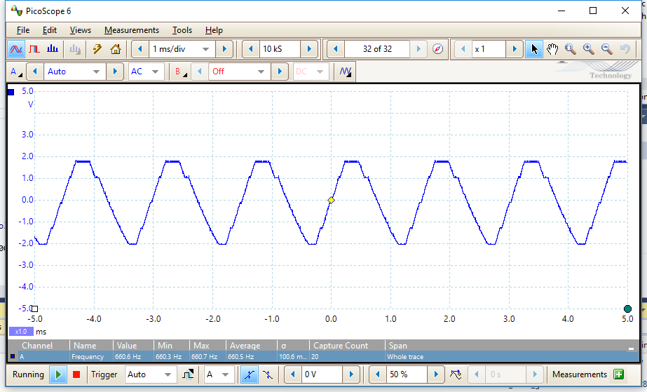
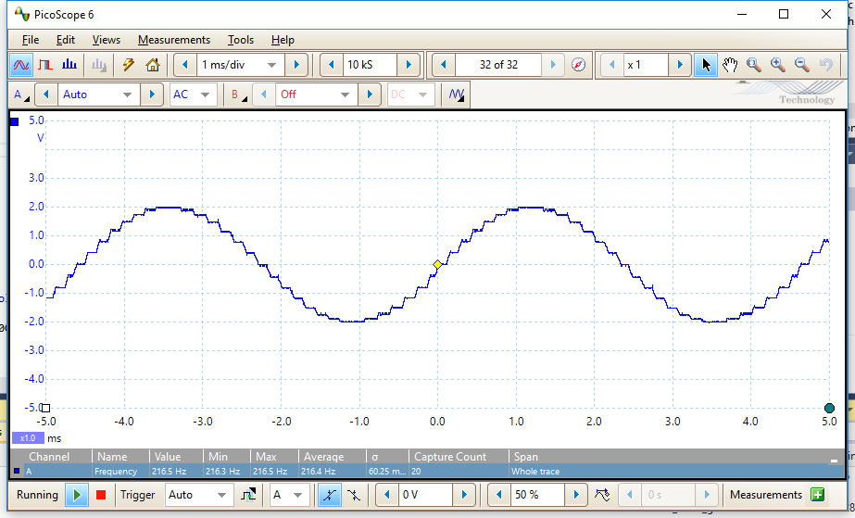
CALCULATED SINE FUNCTIONS
sample size: 6
freqency: 1100 Hz
sample size: 3
freqency: 2300 Hz
sample size: 10
freqency: 660
sample size: 30
freqency: 216

Slide 2
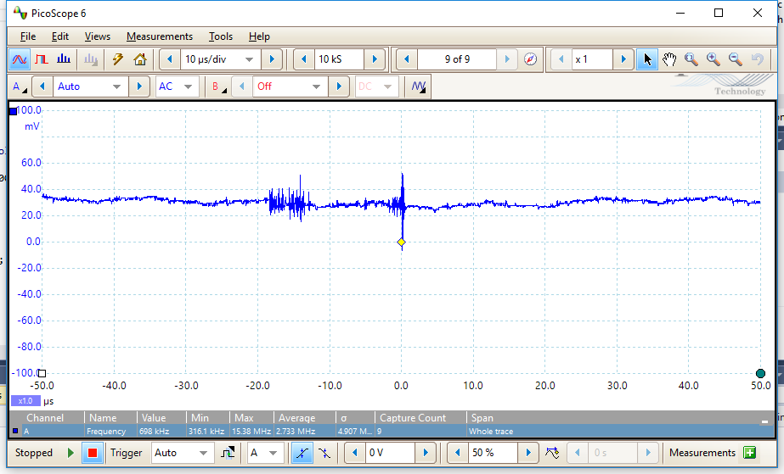
CALCULATED SINE FUNCTIONS
sample size: 10000
freqency: -

Slide 3
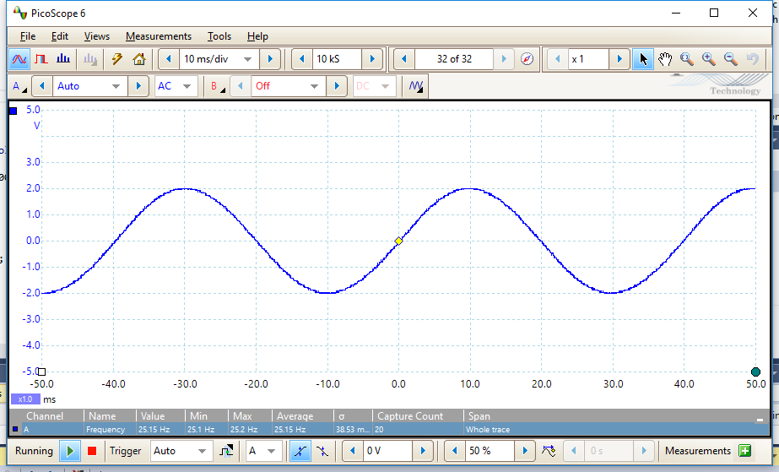
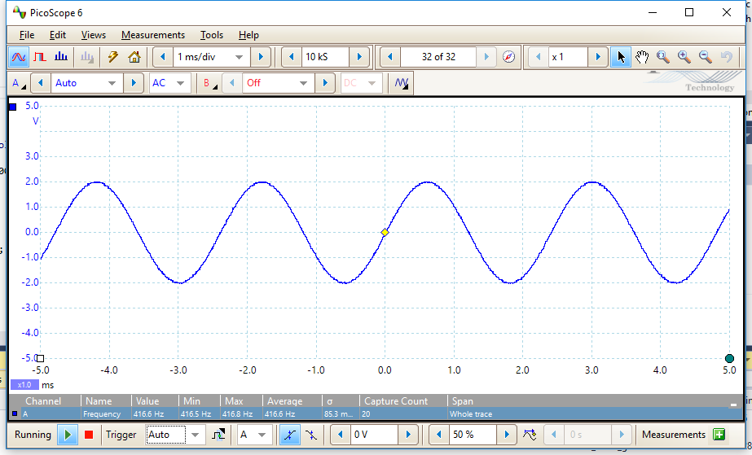
CALCULATED VS. LOOKUP SINE FUNCTIONS
CALCULATED
sample size: 256
freqency: 25 Hz
LOOKUP
sample size: 256
Freqency: 416 Hz

